Slide 1
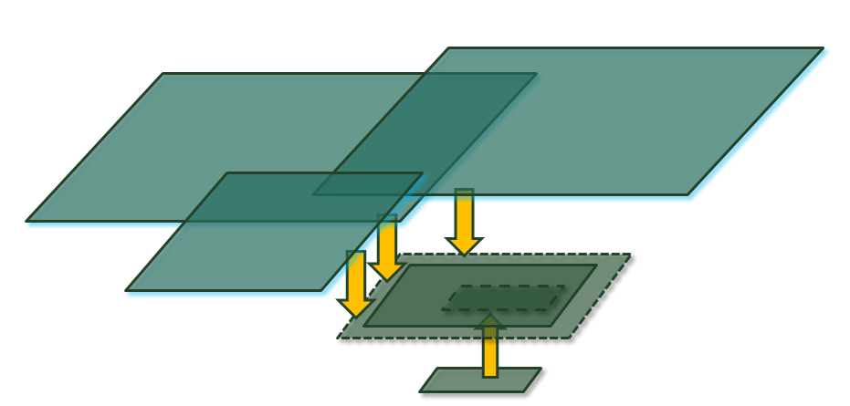
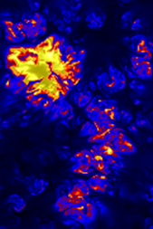
Current numerical approaches and how to expand them: The Task-based Computing Revolution
RoCMI, February 27, 2023
Åke Nordlund
Niels Bohr Institute, University of Copenhagen

Slide 2
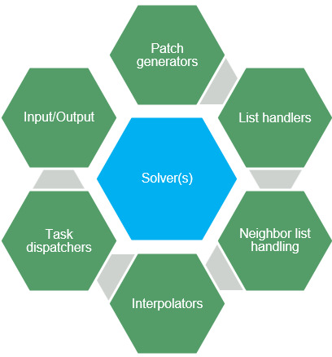
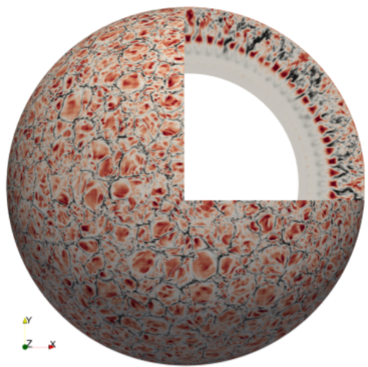
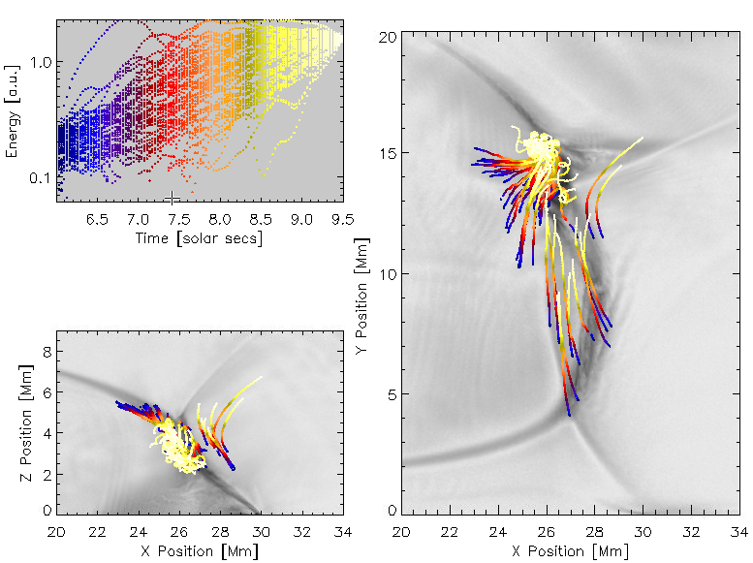
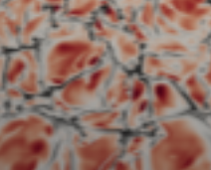
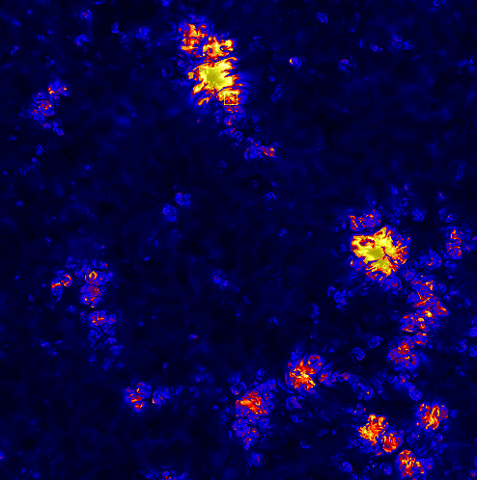
Topics & Questions:
What is Task-based Computing?
What is a Code Framework?
What are the benefits?
What is the current status of this?
What are the future perspectives?
What are “zoom-simulations”?
The bottom line here is: The chromosphere & corona dynamics must – and can – be seen, modeled, and understood in a global context !

Slide 3
What is Task-based Computing?
Let’s take a concrete example, from one of
Bob Stein’s photospheric simulations:
Box: 48 x 48 x 20 Mm
Mesh: 2016 x 2016 x 500
Resolution: 23 x 23 x 10-30 km
At the time this was run on 4032 cores
(42 x 96 MPI ranks) at NASA (Pleiades).
Using similar domain decomposition, today
this could be done with for example 16 MPI
ranks, each with 64 cores parallelized with
OpenMP, giving a 4 x 4 domain decomposition
Such domain decompositions update in
lock-step, and have to respect the highest
fast-mode speed – over 600 km/s here,
giving timesteps counted in milli-seconds.
Near-surface
fast mode speed

Slide 4
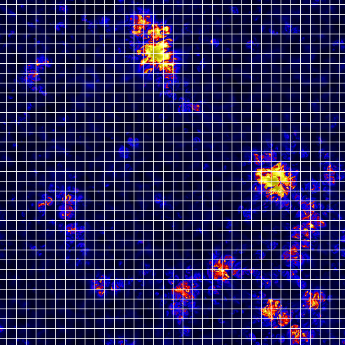
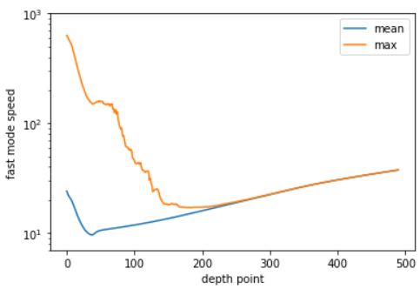
What is Task-based Computing?
Now lets instead split the same problem into
a very large number of much smaller domains:
If we choose for example 28x28x28 cells per
task, we will have 72x72x18 ~ 93,000 tasks.
We still have 16x64 = 1024 cores, and if tasks
are all updated one-by-one, each core will have
to update about 90 tasks to move forwards one
timestep, and nothing has been gained.
BUT, if every task is free to just respect
the local fast-mode speed, a huge reduction
in cost is achieved: The cost per task is
proportional to the fast-mode speed, so the
cost reduction is essentially the max divided
by the mean = a factor ~30 gained in this case.
For chromosphere-corona sims: much more!
To allow each task to update independently basically only requires
that guard zone interpolations are done in space-time, not just in space

Slide 5
What is Task-based Computing?
In addition to letting each task
choose its own timestep, one
can also let the type of solver
vary according to local conditions, with e.g.:
ideal MHD in the photosphere
non-ideal MHD higher up
relativistic particle-in-cell in local hot-spots
This calls for a flexible code
framework …

Slide 6
What is a Code Framework?
The DISPATCH Code Framework turns upside-down (or inside-out) the normal concept of a code, which calls sub-modules and ”libraries”:
Solver(s)
Patch generators
List handlers
Neighbor list handling
Interpolators
Task dispatchers
Input/Output
My Code
(with OpenMP)
Input/Output
MPI
Riemann,
Stagger
AMR (with interpolation)
“Don’t call me – I’ll call you !”

Slide 7
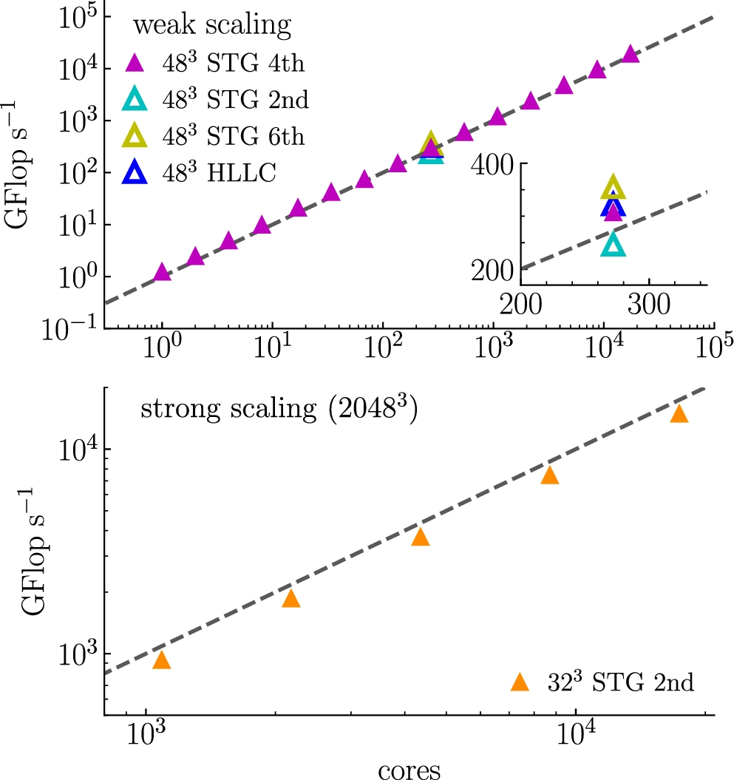
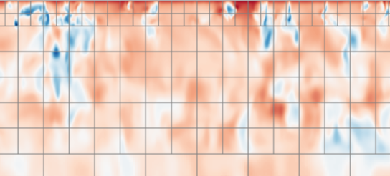
What are the framework benefits?
There are several benefits:
Cost reduction – cf. previous slides
Advantage increases with complexity
Problem size favorable for cache-coherency
Scalability – scaling is theoretically unlimited
Nearly embarrassingly-parallel OpenMP on ranks
Nearest-neighbor MPI communications
Object-oriented approach encouraged
Solver-agnostic – parallelized by framework
Multi-scale contexts
Static and adaptive mesh refinement (AMR)
Hierarchical task grouping via “task lists”

Slide 8
Object-orientation benefits?
Abstraction – the ‘dispatcher’ sees only ‘tasks’, with task%update() methods
Solver-agnostic – solvers are task methods, details are unimportant
Inheritance – more complex objects are made as ‘extensions’ of simpler objects
Basic task, grid task, particle tasks – may be freely mixed
Encapsulation – data are ‘hidden’ inside objects
Mesh properties – are for example only relevant for grid methods
Polymorphism – the same operation are valid on different objects
Hash tables store and retrieve range of properties – e.g. numbers, pointers, ..
Generic ‘add’ and ‘remove’

Slide 9
What is the current status of this?
Framework – dispatcher, parallelism
OpenMP – dispatcher serves new tasks to threads that finish updates
MPI/UCX – sends/recvs messages to/from neighbors (nbors)
Solvers – mesh, particles (some with GPU implementations)
HD/ideal-,nonideal-MHD, Stagger/Riemann, RT(short char.)
Particle-in-cell (PIC) for charged particle and dust-gas, ...
Multi3D (Richard Hoppe, Heidelberg)
Applications – aka ‘experiments’
Stellar atmospheres, 3D-NLTE – Bergemann’s group
Whole Sun – RoCS Pilot paper (Popovas et al) on arXiv
Bifrost physics – implemented as “extras” modules
Star Formation – Self-consistent ISM with supernova driving, heating, cooling, ..
Applications – the same operation are valid on different objects
Hash tables store and retrieve range of properties – e.g. numbers, pointers, ..
Generic ‘add’ and ‘remove’

Slide 10
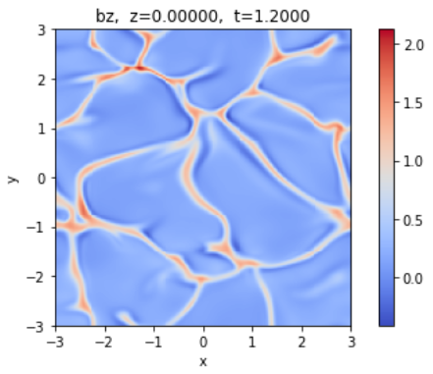
Blind test – which one is Stagger, which one Riemann?
Vertical magnetic field test …

Slide 11
Blind test – which one is Stagger, which one Riemann?
Stagger
Riemann

Slide 12
Blind test – which one is Stagger, which one Riemann?
Stagger

Slide 13
Blind test – which one is Stagger, which one Riemann?
-
Riemann
Stagger

Slide 14
Blind test – which one is Stagger, which one Riemann?
Stagger
Riemann
240x240
160x160
Very importantly, the effective diffusion in HLLC and HLLD Riemann schemes goes to zero in the limit of zero velocity – crucial for deep convection zone !
(240/160)⁴ ≈ 5

Slide 15
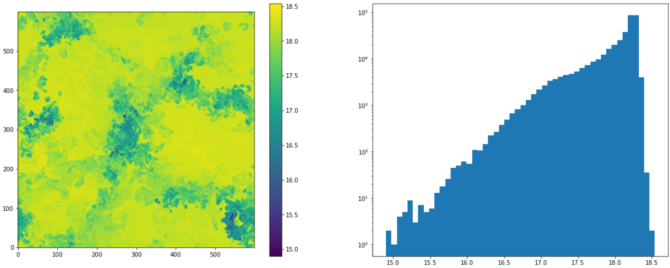
Internal energy, 6x6 Mm box, 10km cells, Riemann solver
This is qualitatively different from the more laminar results with 50km cells; the distribution is self-similar (probably fractal), with 50% flux carried by 3% area !

Slide 16
What are the future perspectives & ambitions?
WholeSun (ERC Syn) & StarCraft (RCN prop.)
Convective Conundrum
Solar and Stellar Cycles
Active Regions
Chromospheres & Coronae
Zoom-simulation concepts applied to the above:
Convection Zone in Dynamo & Cycle context
Flux Emergence and Active Regions in Convection Zone context
Active Region Activity in Magnetic Flux Emergence Context
Corona & Particle Acceleration in Active Region Context

Slide 17
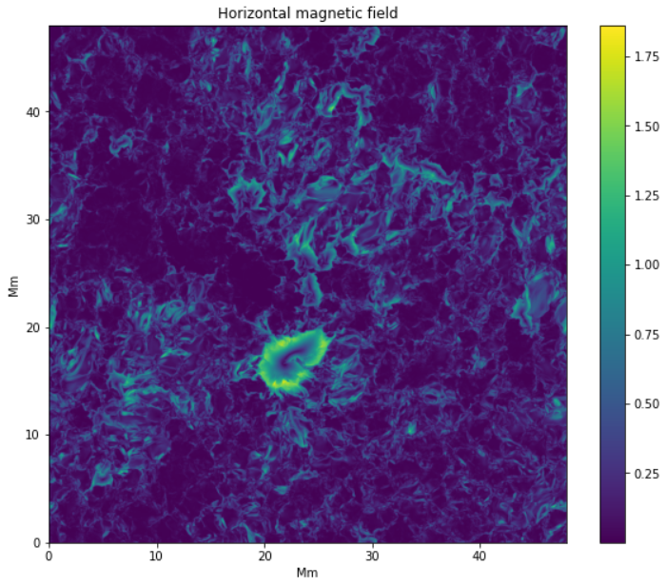
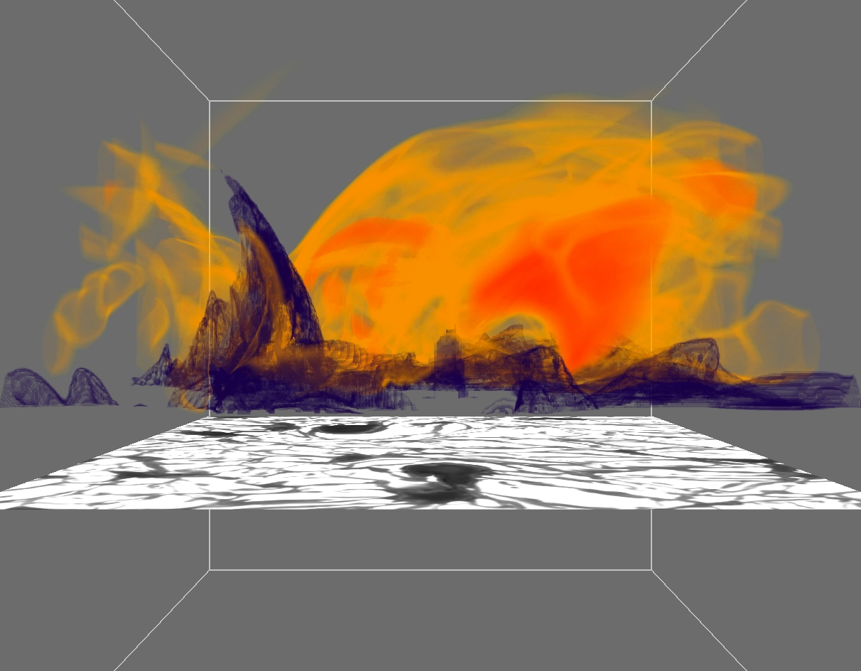
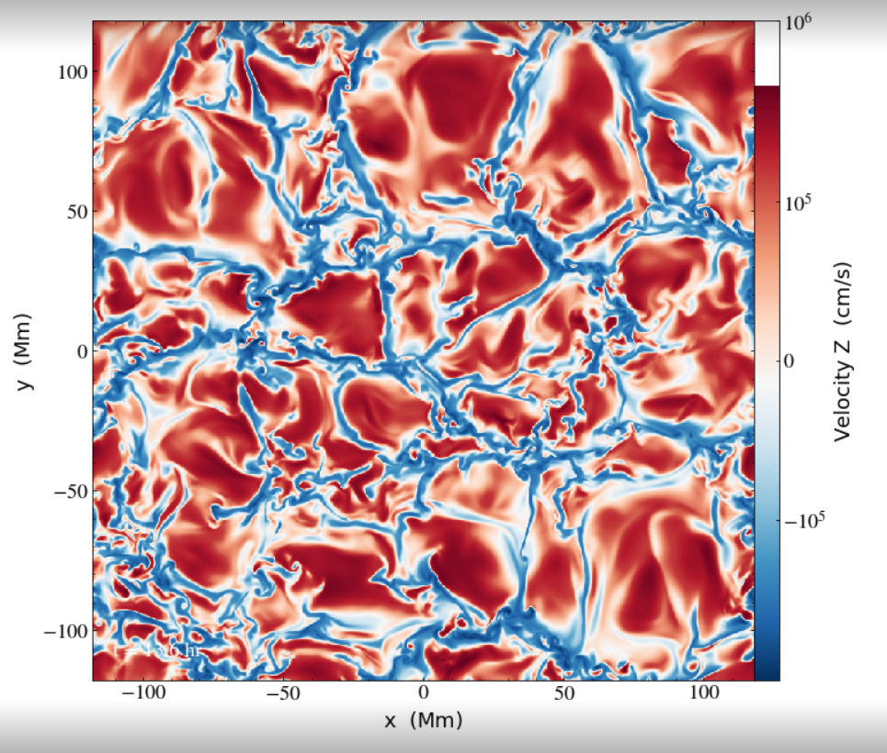
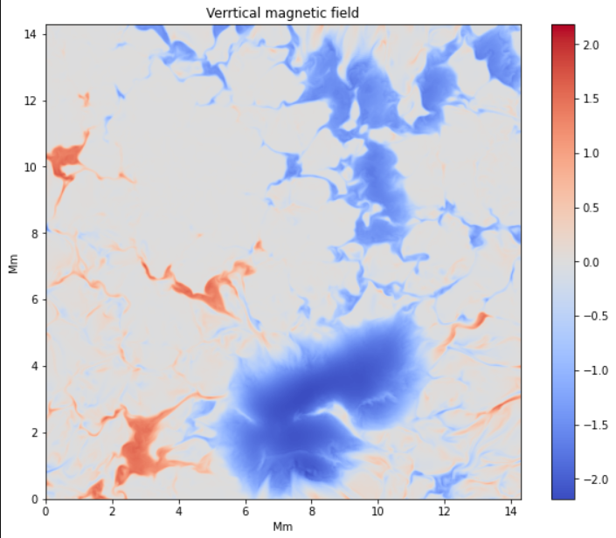
What are “zoom-simulations”?
Zoom-simulations can cover an arbitrary range of scales, by “zooming in” –
in space and time – using larger scales as effectively a mix of initial conditions
and boundary conditions

Slide 18
Summary
What is Task-based Computing?
Space-time decomposition
What is a Code Framework?
Object oriented modularity
What are the benefits?
Tremendous cost reduction!
What is the current status of this?
Works, pilot paper submitted
What are the future perspectives?
Virtually unlimited
What are “zoom-simulations”?
Space-time Adaptive Mesh Refinement

Slide 19
Thanks for your attention!

